Slide 1
Process Synchronization And Semaphore

Slide 2

Process Synchronization
Process Synchronization means sharing system resources by processes in a such a way that, Concurrent access to shared data is handled thereby minimizing the chance of inconsistent data. Maintaining data consistency demands mechanisms to ensure synchronized execution of cooperating processes.

Slide 3
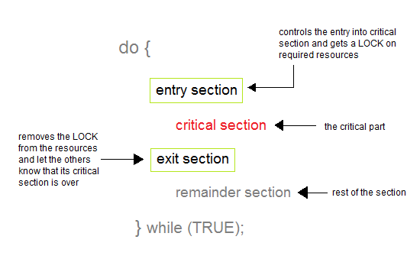
Critical Section Problem
A Critical Section is a code segment that accesses shared variables and has to be executed as an atomic action. It means that in a group of cooperating processes, at a given point of time, only one process must be executing its critical section. If any other process also wants to execute its critical section, it must wait until the first one finishes.

Slide 4
Solution to Critical Section Problem
A solution to the critical section problem must satisfy the following three conditions:
Mutual Exclusion: Out of a group of cooperating processes, only one process can be in its critical section at a given point of time.
Progress: If no process is in its critical section, and if one or more threads want to execute their critical section then any one of these threads must be allowed to get into its critical section.
Bounded Waiting: After a process makes a request for getting into its critical section, there is a limit for how many other processes can get into their critical section, before this process's request is granted. So after the limit is reached, system must grant the process permission to get into its critical section.

Slide 5
Semaphore
In 1965, Dijkstra proposed a new and very significant technique for managing concurrent processes by using the value of a simple integer variable to synchronize the progress of interacting processes.
This integer variable is called semaphore. So it is basically a synchronizing tool and is accessed only through two low standard atomic operations, wait and signal designated by P(S) and V(S) respectively.
In very simple words, semaphore is a variable which can hold only a non-negative Integer value, shared between all the threads, with operations wait and signal.

Slide 6
Wait and Signal
The classical definitions of wait and signal are:
Wait: Decrements the value of its argument S, as soon as it would become non-negative(greater than or equal to 1).
Signal: Increments the value of its argument S, as there is no more process blocked on the queue.
Wait(s): while s<=0 do no-operation
s=s-1
Signal(s): s=s+1

Slide 7
Properties of Semaphores
It's simple and always have a non-negative Integer value.
Works with many processes.
Can have many different critical sections with different semaphores.
Each critical section has unique access semaphores.
Can permit multiple processes into the critical section at once, if desirable.

Slide 8
Types of Semaphores
Two of the different types of semaphores are:
1. Binary Semaphore: It is a special form of semaphore used for implementing mutual exclusion, hence it is often called a Mutex. A binary semaphore is initialized to 1 and only takes the values 0 and 1 during execution of a program.
2. Record Based Semaphore: It generally contains a queue of processes and mutex as integer.

Slide 9
Record Based Semaphore
Type semaphore=record
value : integer
L : List of process
End
Var s semaphore
Wait (s) : s.value = s.value – 1
if s.value < 0
then begin
add the process to s.L
block
end
Signal (s) : s.value = s.value + 1
if s.value <= 0
then begin
remove a process p from s.L
wake up(p)
end

Slide 10
Binary Semaphore
Type binary-semaphore = record
value : (0,1)
queue : List of process
End
Var s binary-semaphore
WaitB (s) : if s.value = 1
then s.value = 0
else begin
place the process to s.queue
Block this process
End
SignalB (s) : if s.queue is empty
then s.value = 1
else begin
remove a process from s.queue
place process p on ready list
End

Slide 11
Classical problems on Synchronization
Here we will discuss about various classic problem of synchronization.
Semaphore can be used in other synchronization problems besides Mutual Exclusion.
Below are some of the classical problem depicting flaws of process synchronaization in systems where cooperating processes are present.
We will discuss the following three problems:
1. Bounded Buffer (Producer-Consumer) Problem
2. Dining Philosophers Problem
3. The Readers Writers Problem

Slide 12
Bounded Buffer Problem
This problem is generalised in terms of the Producer Consumer problem, where a finite buffer pool is used to exchange messages between producer and consumer processes.
Because the buffer pool has a maximum size, this problem is often called the Bounded buffer problem.
Solution to this problem is, creating two counting semaphores "full" and "empty" to keep track of the current number of full and empty buffers respectively.

Slide 13
Dining Philosophers Problem
The dining philosopher's problem involves the allocation of limited resources to a group of processes in a deadlock-free and starvation-free manner.
There are five philosophers sitting around a table, in which there are five chopsticks/forks kept beside them and a bowl of rice in the centre, When a philosopher wants to eat, he uses two chopsticks - one from their left and one from their right. When a philosopher wants to think, he keeps down both chopsticks at their original place.

Slide 14
The Readers Writers Problem
In this problem there are some processes(called readers) that only read the shared data, and never change it, and there are other processes(called writers) who may change the data in addition to reading, or instead of reading it.
There are various type of readers-writers problem, most centred on relative priorities of readers and writers.

Slide 15
Limitations of Semaphores
Priority Inversion is a big limitation of semaphores.
Their use is not enforced, but is by convention only.
With improper use, a process may block indefinitely. Such a situation is called Deadlock.

